Slide 1



Fitness Made Simple
A safe place for individuals who want to improve their health.
We aim to provide members with a clean and affordable gym that offers quality equipment and an enjoyable atmosphere for workouts. Our mission is to get our members fit while keeping costs for both them and us as affordable as possible
DAILY DOSE OF IRON
Contact
Talha Ikram
FITNESS IS A CHOICE, NOT AN OBLIGATION​

Slide 2
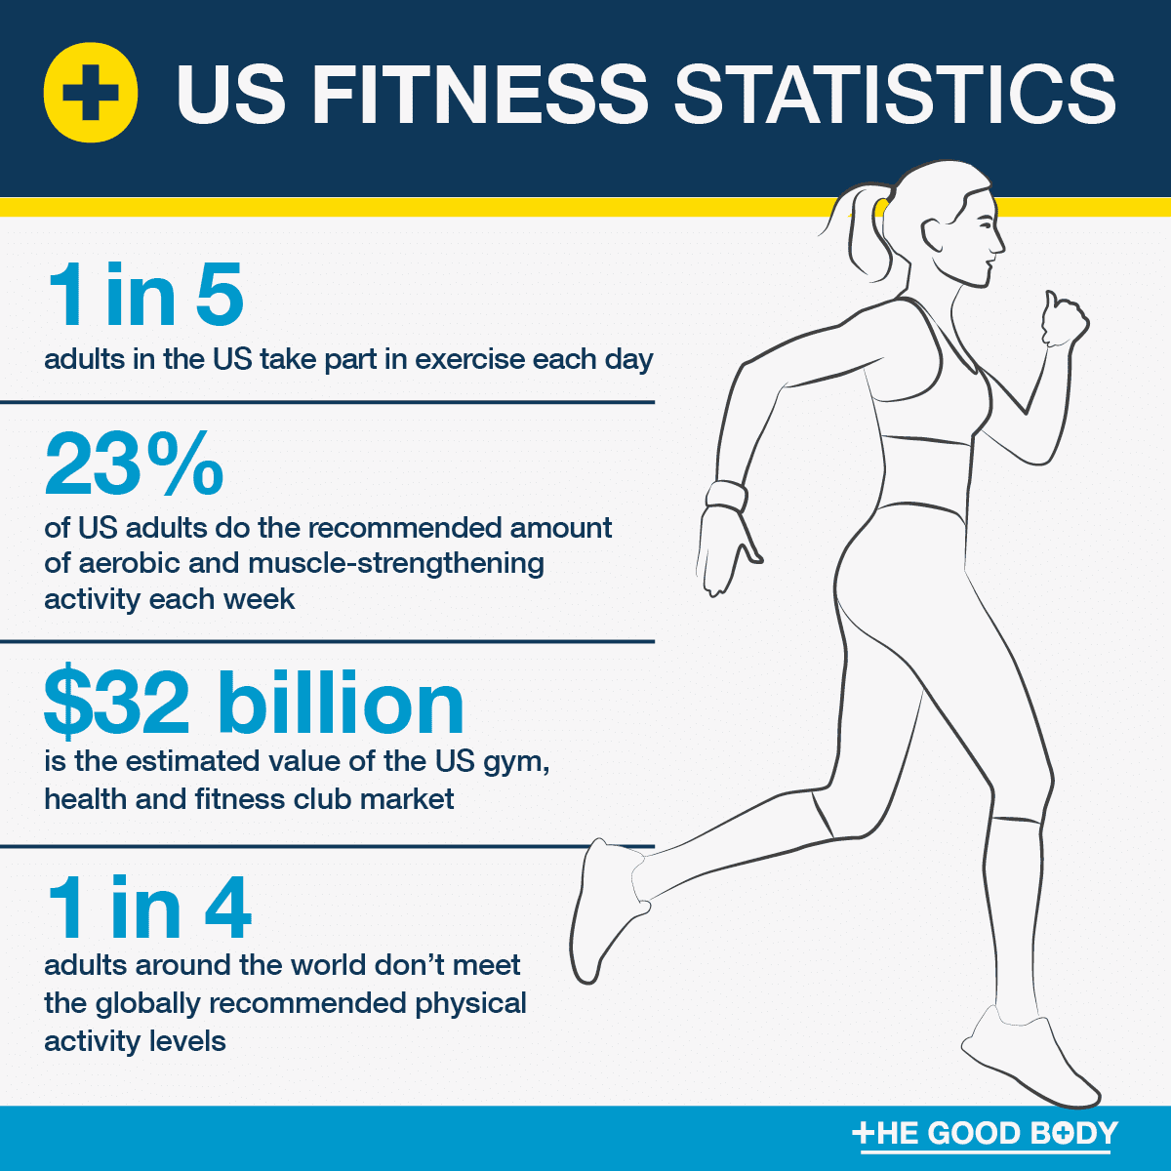
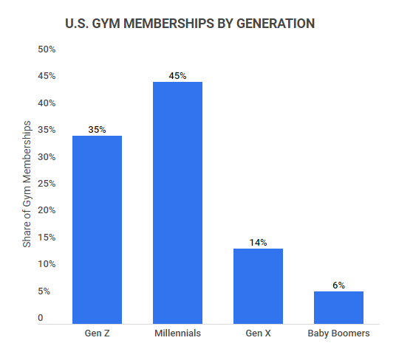

Services
Opportunity
Fitness industry is evolving and more people are now interested in it. according to the recent studies
In 2023, US fitness industry revenue was $30.8 billion.
In NJ alone is $1.3 billion.
Around 39% of Americans have GYM memberships.
it is estimated that fitness industry will grow 171.75% - $434.74 billion.
Our targeted age group is the most interested in fitness and spend on memberships.
We offer a wide range of services and products to meet the needs of our members from diverse backgrounds. Our goal is to provide a safe, stress relieving and affordable services to everyone. This gym will be a great spot for improving fitness.
Personal training | Group sessions
Nutrition guidance | Yoga Sessions
Fitness center | Group Sessions
Pilates | Zumba

Slide 3
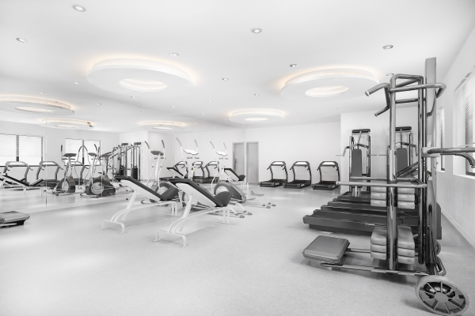
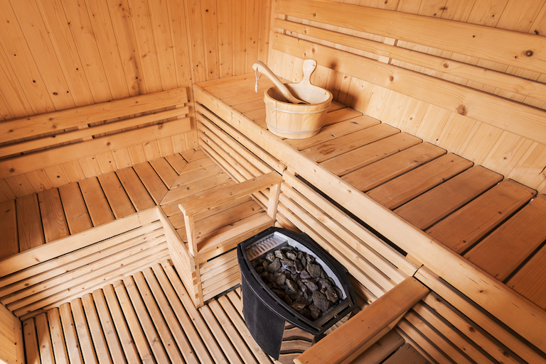
EQUIPMENT
Daily Dose of Iron prides itself on offering the highest quality equipment to our members, all presented in a clean and aesthetically pleasing environment
WHAT SETS US APART
Amenities
Amenities include a sauna, a locker room where each member gets their own personal locker, assigned upon signup

Slide 4
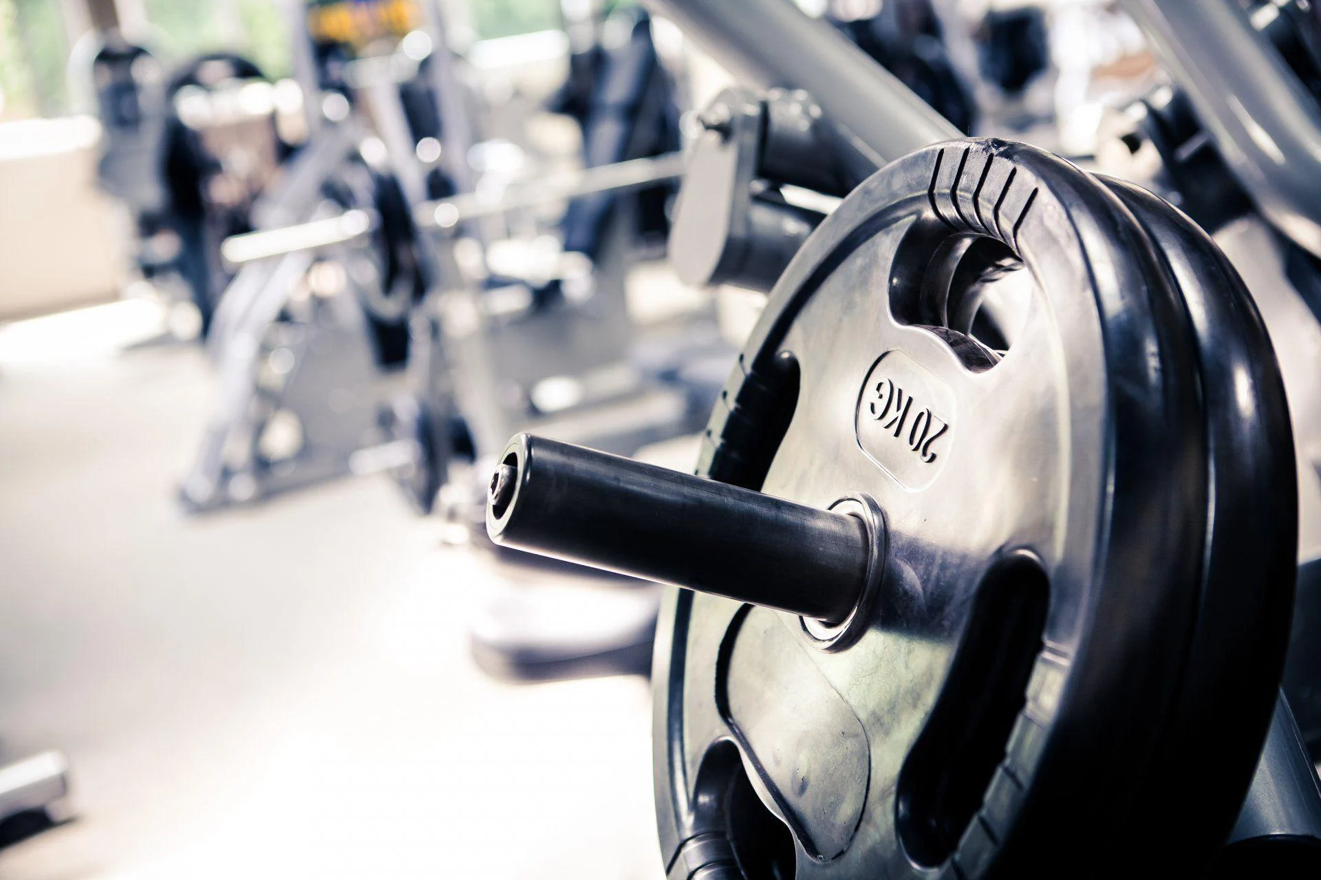

PRICING
Members can enroll on a weekly, monthly, or yearly basis
Enrolling yearly will result in a discount
Prices will be $360 for a year membership, $40 for a month’s membership, and $15 for a week, but if you prepay your membership you will receive an additional 10% discount.
Members can cancel anytime, but prepaid memberships are non-refundable
Our prices were determined by researching pricing for competing upper end gyms in the area (for example, one gym in Northfield charges a whopping $480 for a year’s membership)

Slide 5


MARKET ANALYSIS
Marketing Strategy
Based on our research we have chosen our location for the gym in Atlantic City, New Jersey near the beach. Our targeted audience is from the age 16 to 45 with motivation and passion to live a healthy and well life.
Our location is strategically chosen by keeping our targeted audience in mind. After a long day at work, our members will be able to achieve their goals from early morning to late at night, with a breathtaking view of the beach.
Our offers and services are tailored to the preference of our members, from the insights that we got from surveys and focus groups.
we have a comprehensive marketing strategy to attract customers and gain attention from them.
we will use social media accounts to promote our gym with pictures and information.
we will have an official website for our gym, with detailed information about our services and products.
we will collaborate with other complementary businesses to promote our gym using flyers and posters.
we will mostly rely on the referrals of our members.
we will also participate in the community events to promote our gym.
IT’S NEVER TOO EARLY OR TOO LATE TO WORK TOWARDS BEING THE HEALTHIEST YOU.

Slide 6
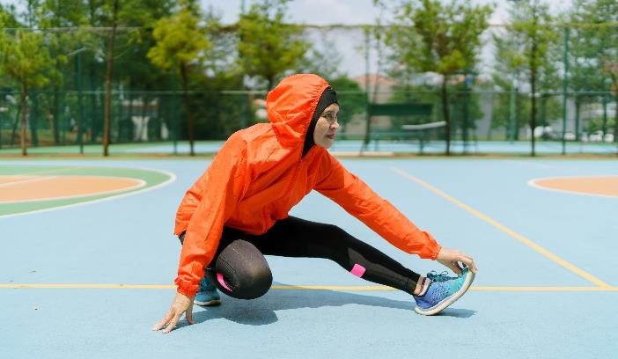

All great achievements require time.”
Maya Angelou
competition
Location
We are in competition with a few gyms in the area, including W.O.L.F. fitness, NYC fitness, and the Atilis Galloway. We can competing by offering promotions and a higher class fitness experience so that we can improve our facility and differ from competitors and be the go to fitness center in AC.
Our prime location will be a free standing building near the AC coastline. We will be equipped with modern equipment and amenities.
keeping the geography in mind, our gym will be near complimentary businesses like, places where you can get health products, grocery, physical therapy, and others.

Slide 7

Costs
Opening this gym will be expensive, we estimate that equipment will cost around $60,000
Rent for a 2,000 square foot building is $5,000 a month
Employees will cost around $5,000 a month, but this cost will be offset by our profits
REVENUE STREAM:
Gyms in the area average around 500-1000 enrolled members in any given month
This means memberships will pull in around $20,000-$30,000 monthly
Some profits will be reinvested into the gym, further increasing our revenue stream when more people enroll
Personnel Plan
Our business will be owned by partners. where we will make important decisions, manage our daily operations, maintenance and implying policies and procedures.
we will have additional help for our front desk services, cleaning, and inventory most importantly our experienced Trainers.

